Slide 1

Business Module 3
Part II Contract Law
By Elena Bundaleska, Ph.D.
Spring 2023

Slide 2
Sources of Obligations

Slide 3
Sources of Obligations
Moral Values – Set of expectations set by the Society, acquired irrespective of one’s Will, through experience, teaching, parents and society (care, fairness, equality, trust, honesty, etc.)
Prescribed – Imposed irrespective of one’s Will (Law)
Agreed – Imposed upon Will (Contracts)

Slide 4
Types of Obligations

Slide 5
Types of Obligations
Moral vs. Civil
MORAL Obligations - Acts prescribed by set of values
Binding
No legal protection
Can not be enforced by court action
No right of compensation for damages
Exmp.: Support of brothers / sisters / parents
CIVIL Obligations - Acts imposed by Law or Contract
Binding
Legal protection
Can be enforced by action
Right of compensation for damages
Exmp.: Child support

Slide 6
Types of Obligations
Law vs. Contract
Obligations Imposed by Law
General Duty of Care – Every person is bound, without contract, to abstain from injuring the person or property of another person or infringing upon his rights
Enforceable by civil action or proceeding
Exmp.: Prohibition to steal
Obligations Imposed by Contract
Agreement of wills
Variety of contracts and obligations imposed by the same
To be studied in details later on

Slide 7
Types of Obligations
Pure vs. Conditional
Pure Obligations
NOT dependant upon any condition
The condition may have existed but it was fulfilled
Exmp.: The buyer will buy the house
Conditional Obligations
Dependant upon condition/s
Suspensive condition (SC)
Resolutory condition (RC)
Exmp.: The buyer will buy the house WHEN the roof of the same is going to be fixed (SC)
The loan is approved, but if the client does not provide collateral up to …, the money shall not be disbursed and the contract shall be canceled (RC)

Slide 8

Condition
Condition must be an EXTERNAL, FUTURE and UNCERTAIN event, that is NOT SOLELY DEPENDENT on the debtor’s will.
4.bp.blogspot.com

Slide 9
Types of Obligations
Joint vs. Several
JOINT Obligations
Several individuals promise or are bound to perform the obligation JOINTLY
Suits may be brought against ANY ONE, MORE or ALL of those who are joint
Party to a joint obligation who satisfies more than his share, may require a proportionate contribution from all the joined parties
Exmp.: Compensation of damages
SEVERAL Obligations
One or several individuals promise to SEPARATELY perform the obligation
EACH of them should be sued SEPARATELY
EACH individual is obligated only to the amount of liability originally designated to him
Exmp.: A debt entered into by two borrowers, where each is responsible only for half of the debt

Slide 10
Types of Obligations
Real vs. Personal
Real Obligation
When a real-estate not directly the person is “liable” for the performance
The property is “liable” for the performance irrespective of the owner of the property
Exmp.: Mortgaged real-estate, i.e. any buyer of a mortgaged real-estate is indirectly liable for the debt because the real-estate is mortgaged
Personal Obligation
When the obligor binds himself to do a thing WITHOUT pledging property
His property is liable for the obligation ONLY while it belongs to him
Exmp.: Loan agreement without mortgage or other type of collateral

Slide 11



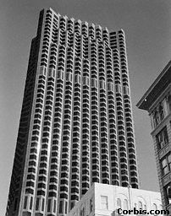
Mirko failed to pay back the Loan, thus decided to sell the apartment
Mirko & Mirka
1. Loan Agreement with Bank
2. The Bank gave Mirko 2 alternatives to pay back the Loan:
Payment of Money or
Performing Services
3. They agreed the money from the Loan to be disbursed only WHEN Mirko establishes mortgage over the apartment
2 Kids &
Parents of Mirko
In the Add it was noted that the new owner will buy mortgaged property
Mirko & Mirka are co owners of the apartment
Bank

Slide 12
Contract Formation

Slide 13



What do these pictures remind you of?
2
1
3
Phases of Contract Formation

Slide 14
Phases of Contract Formation
The Offer Phase
The Post-Offer Phase / Pre-Acceptance Phase
The Acceptance Phase

Slide 15
The Offer Phase
Determining when an Offer is made
Joke
Advertisement
Offers to the Public at Large
Elements of an Offer

Slide 16
Joke^{Q}
An objective (expressed) intent rather then subjective (unexpressed) intent determines whether an Offer has been extended
In other words: If you are Joking with somebody while negotiating you better make sure that somebody understands that it is a Joke!!!

Slide 17
Advertisement
Advertisements usually are NOT Offers, but Invitations to Treat (or “Bargain" in the US)
However there are EXCEPTIONS to this Rule, i.e.:
Where an advertisement is clear, definite and explicit and leaves nothing open to negotiation, it constitutes an Offer
Example:
Saturday (21.10.2023) 9.00 a.m. in the stores of VERO, the apples worth MKD 50 per 1kg will be sold for MKD 25 per 1kg, on a first come first serve basis!
Is this an Offer or an Invitation to treat/ bargain?

Slide 18

The Mirror Image Rule
The Offeree must accept the Offer exactly as it is, WITHOUT CHANGING IT
I promise to pay 200$ (PLUS 400$ deposit) a month for your promise to rent your apartment to me | I promise to rent you my apartment for 200$ a month PLUS 400$ deposit | I promise to pay 200$ a month for your promise to rent your apartment to me WITHOUT a deposit
Acceptance | Offer | Rejection & Counteroffer

Slide 19
Rules of Acceptance
The Mailbox Rule
The Mailbox Rule:
it only applies to ACCEPTANCE (not to Offer),
mail is method of acceptance,
does not apply to acceptance by fax or telephone,
the contract has been formed when the letter of acceptance WAS POSTED = placed in the mailbox = in a possession of the Post Office,
It is NOT considered posted if the letter of acceptance was handed to an agent to deliver (such as a courier)

Slide 20

The Mailbox Rule
1) What if the letter of acceptance was posted but got lost???
2) Exercise:
Katerina makes an Offer to sell her yacht to Marin on January 1, 2023. Katerina then decides to REVOKE the Offer on January 2, 2023 and mails a letter revoking the Offer. Marin mails the letter accepting the Offer on January 3, 2023, and receives the revocation letter on January 4, 2023.
Will the letter of revocation be effective on January 2, 2023 or on January 4, 2023? Was a contract concluded?
See page 30 of the Book

Slide 21
A Valid Contract
Elements of Enforceable Contract

Slide 22
Elements of Enforceable Contract
Subject….
Basis….
Capacity
Will
Form…
Must also see Slide 75 – To Conclude

Slide 23
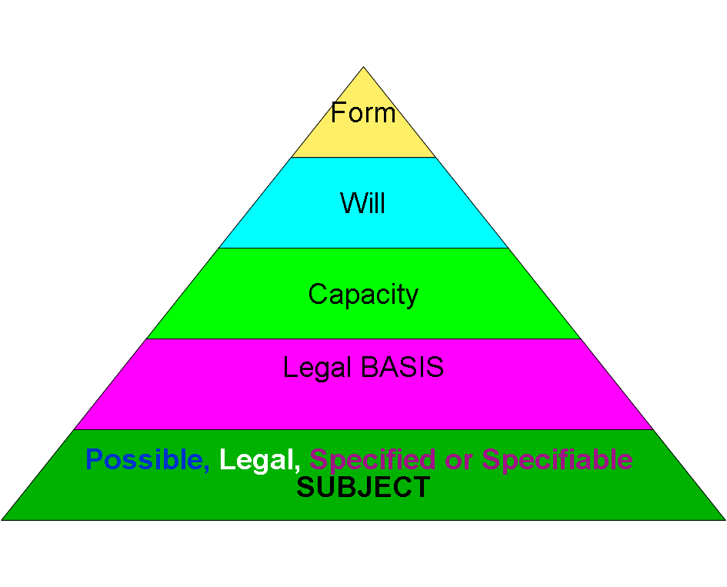
Elements of Enforceable Contract

Slide 24
Subject - PREDMET
The Subject must be:
Possible i.e. Achievable (by average person)
……..fly to Mars in 2 hours (?) ……….
Legal
……sell of army trucks to non-military person (?) …
Specified or Specifiable
……purchase of a house…. (without specifying which house) (?)……
Contract with Impossible, Illegal or Unspecified and Unspecifiable Subject is INVALID or VOID (Ништовен договор)

Slide 25
Basis - OSNOV
Reason/Grounds on which any contract is concluded
It should be LEGAL
Ex. Advertising and Marketing Agencies conclude contracts with clients BASED on relevant laws
Banks conclude loan agreements BASED on the Central Bank LICENSES allowing them to disburse loans + given set of rules + client requests
The legal BASIS for contracting between certain Government Agencies may be Policy Statement, or specific law …
Contract with Illegal Basis is INVALID (Ништовен договор)

Slide 26
Capacity
Capacity is a term used to define someone who is able to understand and appreciate the consequences of his/her actions.
There are two “types” of Capacity: a) General Capacity - to CARRY rights and certain (limited) duties …. and
b) Business/Contractual Capacity:
- to conclude binding contracts or to perform other activities, resulting in duties and OBLIGATIONS,
to access the civil and juridical system, i.e. right to sue and be sued in its own name, and
legal independence to speak on one’s own behalf.

Slide 27
Capacity
Individuals vs. Legal Entities
Individuals gain capacity to conclude contracts at certain stage of their mental development, while legal entities gain capacity to conclude contracts upon registration with the relevant body.
The extent of the capacity of a legal entity depends on:
a) the law of the place of incorporation and
b) the enabling provisions included in the constitutive documents of incorporation.
The general rule is that anything not included in the corporation's capacity, whether expressly or by implication, is "beyond the power" of the corporation.

Slide 28
Capacity
Lack of Capacity can arise due to:
Minors (Infancy)
and
Mental Incapacity due to:
    Mental Illness or
    Mental Handicap or
    Alcohol or Other Drugs Abuse
What about Elderly people???

Slide 29
Will
Both sides must have a will=intent to enter into binding contractual relationship
Meeting of the Minds – each party must freely and voluntarily agree to the terms of the contract
Situations where there is NO will:
Force = Сила/Закана
Mistaken Assumption = Заблуда
Miscommunication = Недоразбирање
Fraud = Измама

Slide 30
Question:
Mistaken Assumption vs. Miscommunication
Interesting Videos:
Translator
http://www.youtube.com/watch?v=VpH5EHEFfIU&feature=related
Language – sinking-thinking
http://www.youtube.com/watch?v=lY0pQ5FZ6ls

Slide 31
Form
In RM:
Contracts may be concluded in ANY form, UNLESS otherwise specified by law
Termination of a contract should be done in the SAME form it was concluded
Some contracts that, according to RM law, should be in writing are: sale of real-estate, gift, construction, all bank contracts, employment, commercial agency, company incorporation contracts, etc.

Slide 32
Form
In US:
Contracts that should be concluded in writing:
Contracts that cannot be performed within 1 year
2) Contracts for transfer of interest in real property (Mortgage, Lease)
3) Contracts for sale of goods for price of $500 or more

Slide 33
To Conclude – Valid Contract Includes:
SUBJECT Possible, Legal and Specified or Specifiable
CAPACITY
Lack of Capacity:
1. Minors (Infancy)
2. Mental Incapacity due to:
Mental Illness or
Mental Handicap or
Alcohol or Other Drugs Abuse
BASIS Legal
WILL
NO Will in case of:
1. Force = Закана
2. Mistaken Assumption
= Заблуда
3. Miscommunication
= Недоразбирање
4. Fraud = Измама
FORM (formal or informal)

Slide 34
Breach of Contract and Remedies

Slide 35
Breach of Contract
TWO Situations, i.e.: Contract has been Breached when the Debtor either:
1) Has NOT performed due (matured) obligation (Breach by Failure to Perform) OR
2) Has NOTIFIED the Creditor that he/she WILL NOT perform (Anticipatory Breach)
When the Creditor receives notice that the Debtor will not perform in the future, the Creditor DOES NOT need to wait for the date when the performance is due, but may immediately take action for Breach of Contract

Slide 36

Remedies for Breach of Contract

Slide 37
Remedies for Breach of Contract
When one party Breaches a Contract, the other party is entitled to
REMEDY/ies
Remedies are the means with which a court:
- enforces a right, and/or
- imposes a penalty, and/or
- makes some other court order to impose its will….

Slide 38
Remedies for Breach of Contract
The REMEDIES should place the NON-breaching party IN a POSITION he/she WOULD HAVE BEEN in, had the contract been fully performed by both parties, according to its terms.

Slide 39
Remedies for Breach of Contract
(continues)
The main Remedies for Breach of Contract are:
Specific Performance!!!
Cancellation and Restitution
(In both cases) Damages

Slide 40
Remedies for Breach of Contract
(continues)
Specific Performance – “Court Ordered” performance of the duty, used MAINLY where a) the subject matter is RARE or UNIQUE AND b) the comp. of damages would NOT PLACE the non-breaching party in a position as it would have been had the Breach not occurred (Example: land transactions, such as sale of land where the seller refuses to pass on the title)
Cancellation and Restitution – Party may cancel the contract and require to be placed in a position it was PRIOR to the contract / Any advanced money are to be returned

Slide 41
Cancellation and Restitution
In RM (Law on Obligations):
It depends on WHETHER the Time of Performance or Specific Performance are ESSENTIAL elements of the Contract or not
(same as “time is of essence”)

Slide 42
Damages
Available no matter if you ask for specific performance or cancellation!!!

Slide 43
Damages
Available no matter if you ask for specific performance or cancellation!!!
Types of losses that may arise from Breach:
pecuniary loss (financial loss) and/or
non-pecuniary loss (mental distress, as disappointment, hurt feelings, humiliation….)
Traditionally, damages were NOT awarded for non-pecuniary losses. Still, in some recent cases of breach of contracts concluded for purpose of pleasure, relaxation or peace of mind, damages for compensation of non-pecuniary losses were awarded (Example: travel arrangements…)

Slide 44
Types of Damages that may be Awarded
Compensatory Damages - intended to compensate the nonbreaching party for not receiving his/her expectation under the contract
Punitive damages - monetary awards that PUNISH the breaching party, BEYOND the compensatory damages, in an effort to DETER the person and others from repeated occurrences of the wrongdoing.
Nominal Damages – damages awarded when a Breach occurred, but NO actual or significant MONEY loss to the nonbreaching party was proved (cases involving violations of constitutional rights, such as freedom of speech…)
Other Types of Compensation (Liquidated Damages, Attorney Fees and Costs, other)

Slide 45
Drafting a Contract

Slide 46
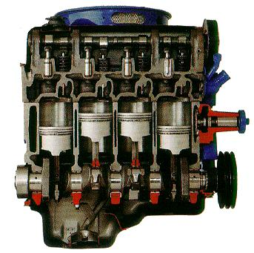
1) It’s as if you were called on to build an ENGINE,
all looks well on the drawing board, but due to deficiencies in the design and specifications, many of the parts DON’T fit together perfectly, and other aren’t of the appropriate “grade of metal”…….
2) You’ve built the engine, and it works, but it leaks “oil”, and makes an odd disturbing sound. You are continuously afraid that it could BLOW UP when you least expect it.

Slide 47
Typical Contract Provisions
1.Parties, Date & Place, Signatures (for legal entities besides signature of an authorized representative: Seal and Reference Number)
2. Rights and Obligations of the Parties
3. Representations and Warranties
4. Remedy Clauses
5. Cancellation and Termination Clauses
6. Applicable Law and Jurisdiction Clauses
7. Term / Effective Date and Expiration Date
8. Integration (“Merger”) Clauses

Slide 48
Parties, Date & Place
Example:
Concluded on January ____, 2016, in Skopje, between:
__________________ AD-Skopje, Head Office: 11 Oktomvri No.____, Skopje, Unique Tax Number _____ (in RM also Unique Identification Number __________), represented by ________________, Manager of the Legal Division, on one side (company)
and
_____________ from Kichevo, address Bul. Osloboduvanje No. __, Kichevo, Unique Identification Number_____________, ID Number__________, on the other side. (individual)

Slide 49
Duties and Obligations of the Parties
Very important clauses! They depend on the type of the contract …, special attention to be given to payment conditions...
Representations and Warranties
Example 1: Loan Contract
The Borrower warrants:
- that the information stated in the financial statements and related materials needed by the Lender, is true, complete and accurate;
that it is the sole owner of the mortgaged real-estate and it has acquired all the necessary documents, approvals, etc. to mortgage the same;
- it has received all the necessary documents, approvals, made decisions, etc. to take the loan (relevant for companies)

Slide 50
Representations and Warranties
Example 2: Sale Contract
The Seller warrants that he is the SOLE owner of the vehicle and has the legal authority to sell the vehicle subject of the sale......
The Seller also warrants that the vehicle subject of the sale is NOT pledged or otherwise subject to any other rights of third persons that may exclude, diminish or limit the rights of the Buyer or the value of the vehicle.

Slide 51
Representations and Warranties
The underlying MATTERS or FACTS as they are being presented in terms of the contract.
They blend the past, present, and future together within the terms of the contract.
The are ASSURANCES that one party gives to another party in a contract. These assurances are statements that the parties can rely on AS FACTUAL.
Breached representations and warranties are the most common cause of litigation in acquisitions.
One should be very careful in determining the breadth and scope of the reps and warranties one is making.

Slide 52
Remedy Clauses
These clauses state what rights the NON-breaching party has if the other party breaches the contract.
Example (Loan Contract): “In the event of default of the Borrower, the Lender has the right to take the following steps:
Stop disbursing loan funds that Borrower has not yet used;
Unilaterally and prior to the regular due date, declare the amounts previously disbursed MATURE and require the Borrower to immediately return the principal and pay all matured interest; and
Take other actions as provided by applicable laws and regulations.”

Slide 53
Cancellation and Termination Clauses
- Termination (ПРЕСТАНОК) occurs when either party pursuant to a power created by contract or law puts an end to the contract OTHERWISE than for its breach.
All obligations which are still executory on both sides are discharged.
Usually with Termination Notice and Set Termination Period. With or Without a Cause.
Some Bases for Termination:
If performance by either party is rendered impossible, (including vis major), or,
Upon death or loss of capacity or bankruptcy of either party, etc.
Other …. specific: if the owner cannot obtain additional financing to complete the work (only if stipulated!)

Slide 54
Cancellation and Termination Clauses
Cancellation (РАСКИНУВАЊЕ) occurs when either party puts an end to a contract for breach by the other.
Same effect as that of "termination“, except that the cancelling party also retains any remedy for breach of the contract or any unperformed obligation.
Usually without Notice and Cancellation Period!
Basis: Breach, non-fulfilment of contractual obligations.
The best time to think about cancelling or terminating a contract is when you are negotiating the contract!

Slide 55
Applicable Law and Jurisdiction Clauses
Example: “This Contract shall be governed by the laws of the Republic of Macedonia. Any litigation under this contract shall be resolved in front of the Skopje Courts.”
(there are many other options….)
Term / Effective Date and Expiration Date
Example:
(1)This contract shall enter into force on____ (Effective Date - usually the day of signing of the contract by all parties) and shall continue for a term of 2 (two) years from the Effective Date.
(2) The term of the contract may be extended only by written annex to this contract, signed by both/all parties.
(there are other options)

Slide 56
Integration (“Merger”) Clauses
Example: “This contract and the attachments hereto contain the entire agreement of the parties with respect to the subject matter of this contract, and SUPERSEDES any and all prior and/or contemporaneous oral or written negotiations, contracts and understandings with respect thereto. This Contract may only be amended by a written document duly signed by all parties.”
The purpose: To prevent the parties of a contract from later claiming that the contract does not reflect their entire understanding, and that it was changed by a subsequent ORAL contract, or is not consistent with prior contracts…..

Slide 57
Signatures
The Signatures should be on the last page of a contract …. they should never be on a separate page!!!!
Sign or initial every page
For legal entities besides signature/s of authorized representative/s also Seal and Reference Number is needed
Attention should be given to verifying the signatures, the seal, the authorizations to sign the relevant contract…

Slide 58
Other Recommendable Clauses
Example: The undersigned warrant that they are duly and fully authorized to sign this contract on behalf of the business represented, that the business entity represented is bound by this contract and there are no restrictions for signing and executing this contract. ….
NON-ASSIGNABILITY: This contract and the rights and obligations arising from the same shall not be assignable....

Slide 59
Example of Safe Harbor Clause
Safe Harbor is a provision of a regulation or a contract that REDUCES OR ELIMINATES a party's liability under the law/contract, on the condition that the party performed its actions in good faith or in compliance with defined standards.
Example: “Statements about the locations and number of new hotels to be opened and their anticipated completion and opening dates are “forward looking statements” within the meaning of federal securities laws, and are subject to a number of risks and uncertainties, which could cause the actual number of new hotels or their completion or opening dates to be different than expected.”

Slide 60
Tips for Contracts
1. Write it down
2.Make sure you are comfortable with your obligations
3. Remember Murphy's Law
4. Don't leave anything out
5. Cover all options
6. Don't use unclear language or try to sound like a lawyer
7. Define any ambiguous terms
8. Be careful using "terms of art“ (legal terms)
9. Use terms consistently

